Slide 1
Ticket System Microservice Project
Jeremiah Dy
Project duration: 1 month (May 2025)

Slide 2
Project Overview
This is a microservice based project intended to model an online ticket-support system, complete with functionality for users, managers, and admin personnel. Upon encountering a problem in the workplace, users can raise a ticket and provide information about their circumstance.
Managers can then view the ticket and either approve or reject them.
Upon approval, tickets are assigned to an admin employee, who then works on the problem until a solution is reached. Afterwards, the admin employee will resolve the ticket, automatically generating an email that lists the ticket details and lifetime for the user.
If the user is satisfied with their solution, they can close the ticket. However, if the user is unsatisfied, they can reopen the ticket, in which the admin employee will be able to work on it again.
At each stage in the ticket lifecycle, when the ticket’s status is changed (created → pending → approval, etc.), a simple notification email is sent to the user to keep them updated.

Slide 3
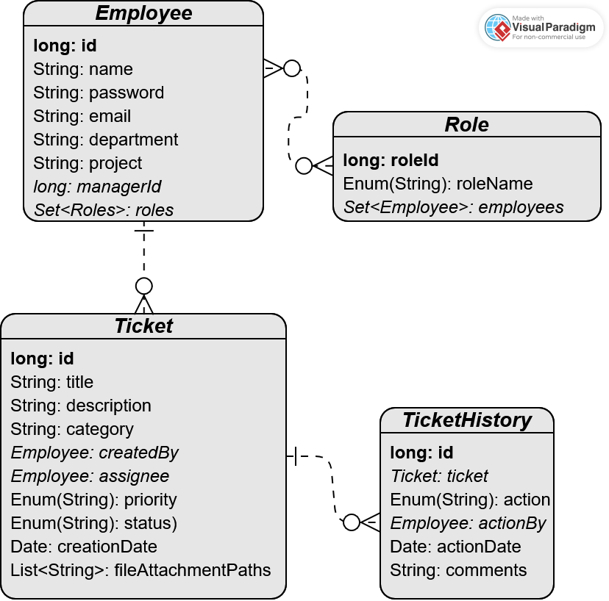
Ticket Entity Relationship Diagram
Employee - Role
Many-to-many
An employee can have multiple roles, and vice versa
Employee - Ticket
One-to-many
FK: createdBy
FK: assignee
An employee can create any number of tickets, but a ticket can only have one creator or assignee
Ticket - TicketHistory
One-to-many
FK: ticket
A ticket will have multiple events in its historical record, but each individual TicketHistory event log will only refer to a single ticket

Slide 4
Project Architecture
notificationmicroservice
ticketmicroservice
Spring-boot
Maven
ActiveMQ
Quartz Scheduler
iText PDF v.5
Jackson (library)
~~~~~~~~~~~~~~~~~~~
This microservice serves the notification portion of the project application.
Upon receiving JMS messages from ticketmicroservice through an ActiveMQ broker, it will generate an email and send it to the email address associated with that user. It also uses Quartz to periodically send a JMS message to ticketmicroservice to check ticket statuses and perform routine tasks (e.g. sending reminder emails, auto-closing inactive tickets).
ticketinggateway
Spring-boot
Maven
Spring Data JPA
MySQL Database
ActiveMQ
Jackson (library)
~~~~~~~~~~~~~~~~~~~
This microservice serves the backend of the project application.
It accesses the MySQL database to create and modify tickets and create a historical record of ticket lifecycle events. It also communicates to notificationmicroservice to send email notifications to users (e.g. MANAGERs and USERs).
Spring-boot
Maven
Spring-security
Spring Data JPA
MySQL Database
jQuery
Bootstrap CSS
~~~~~~~~~~~~~~~~~~~
This microservice serves the frontend of the project application.
It allows users to login/logout and create/modify/view tickets through HTTP requests to ticketmicroservice.

Slide 5
User Login Flow Diagram
Logout
User Login Page
Manager Dashboard
Manager
Role
User Register Page
Successful login
Landing Page
Admin Dashboard
Admin
Role
Does user have authority to access?
User Dashboard
User
Role

Slide 6
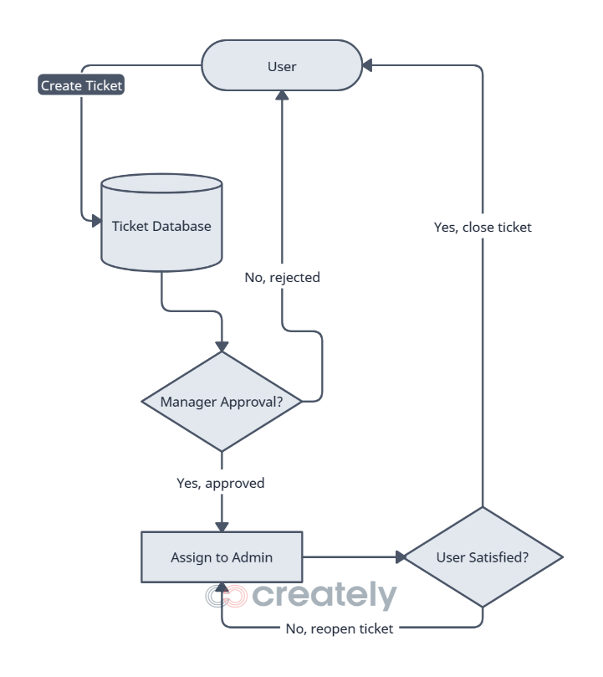
Ticket Lifecycle Flow Diagram
User creates a ticket*
Manager sees ticket
Approved? Assign to Admin*
Rejected? End of ticket life*
Admin resolves assigned ticket*
User views resolved ticket
User satisfied? Close ticket*
User unsatisfied? Reopen ticket and send back to Admin employee*
* Denotes a DB change and email
notification

Slide 7
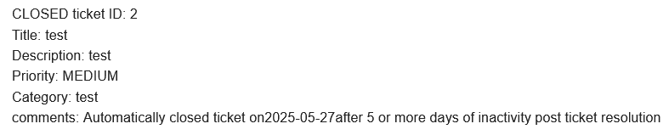
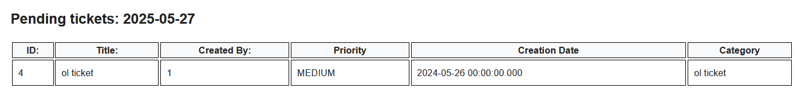
CRON Jobs using Quartz
Quartz jobs are used to send JavaMessageService notifications from notificationmicroservice to ticketmicroservice. Upon receiving this JMS message, ticketmicroservice will check for pending tickets and automatically close any inactive, RESOLVED tickets. Email notifications are sent to MANAGERs for pending tickets. Similarly, email notifications are sent upon auto-close of any inactive tickets.

Slide 8
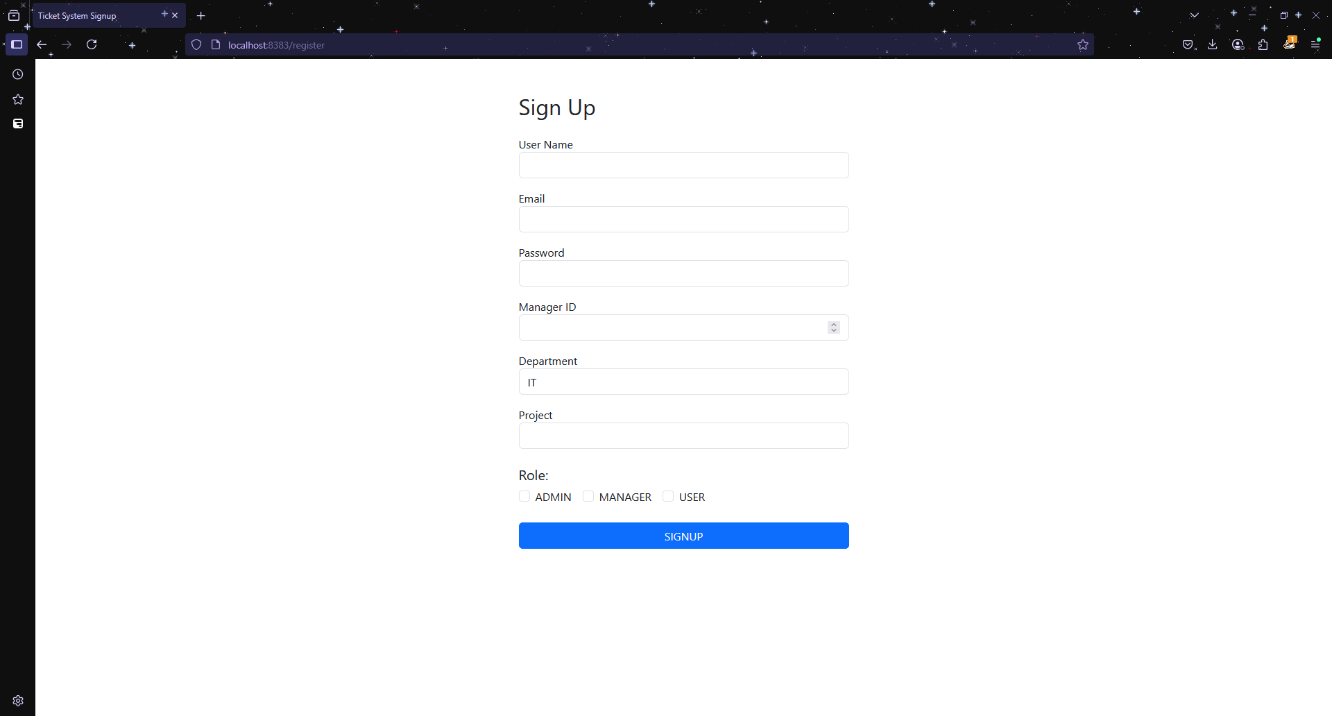
User Signup

Slide 9
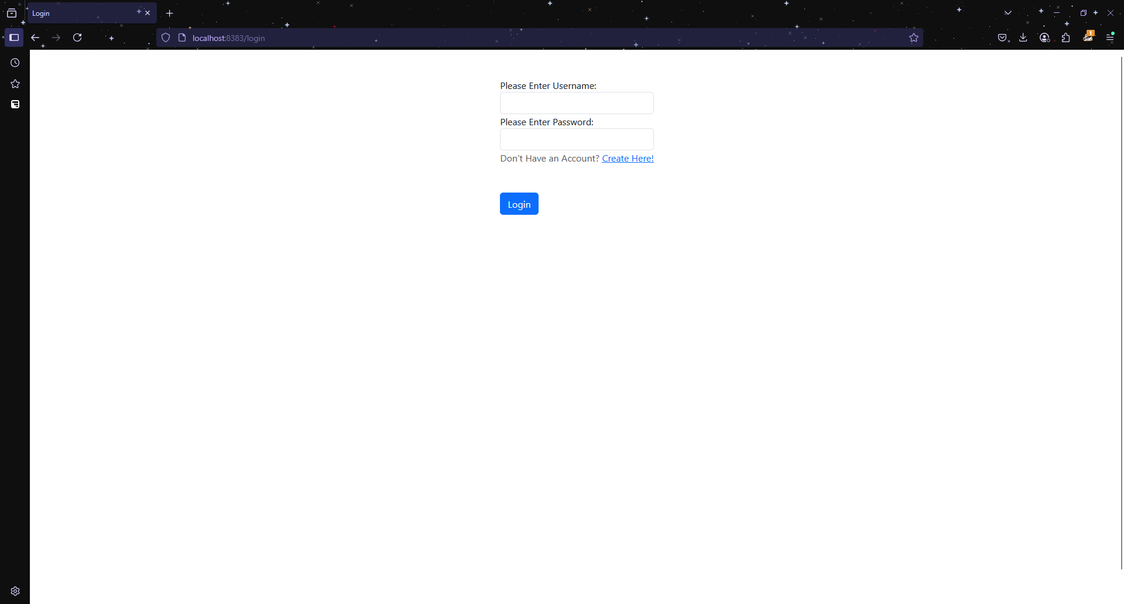
User Login

Slide 10
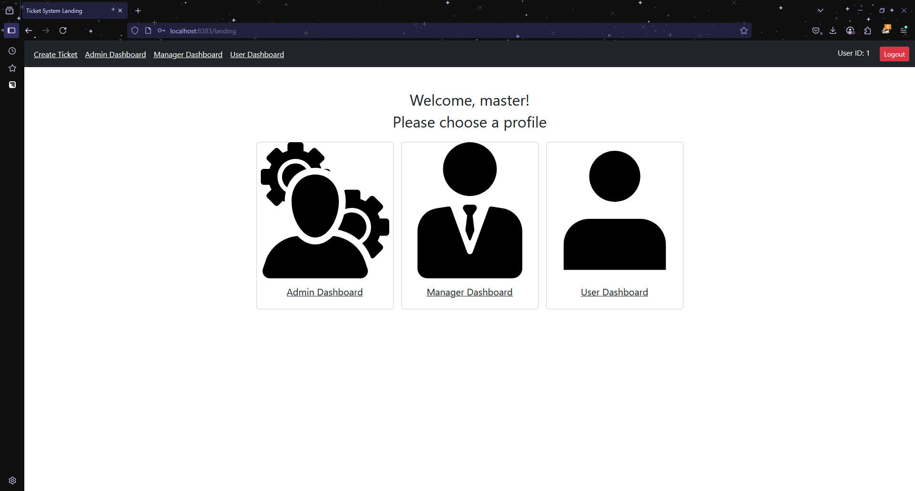
Landing

Slide 11
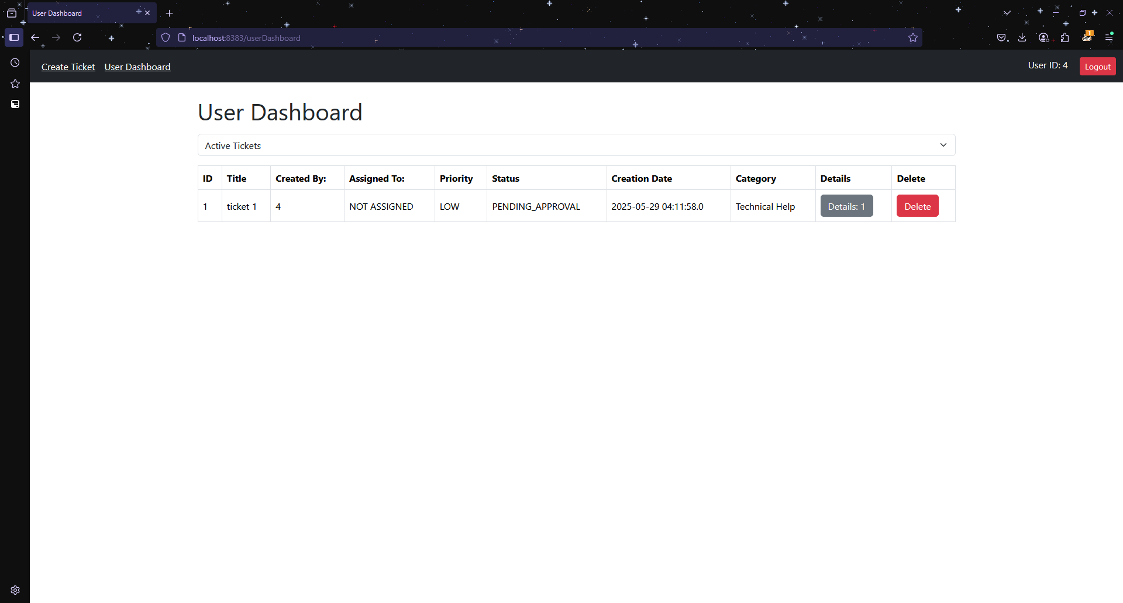
User Dashboard (active tickets)

Slide 12
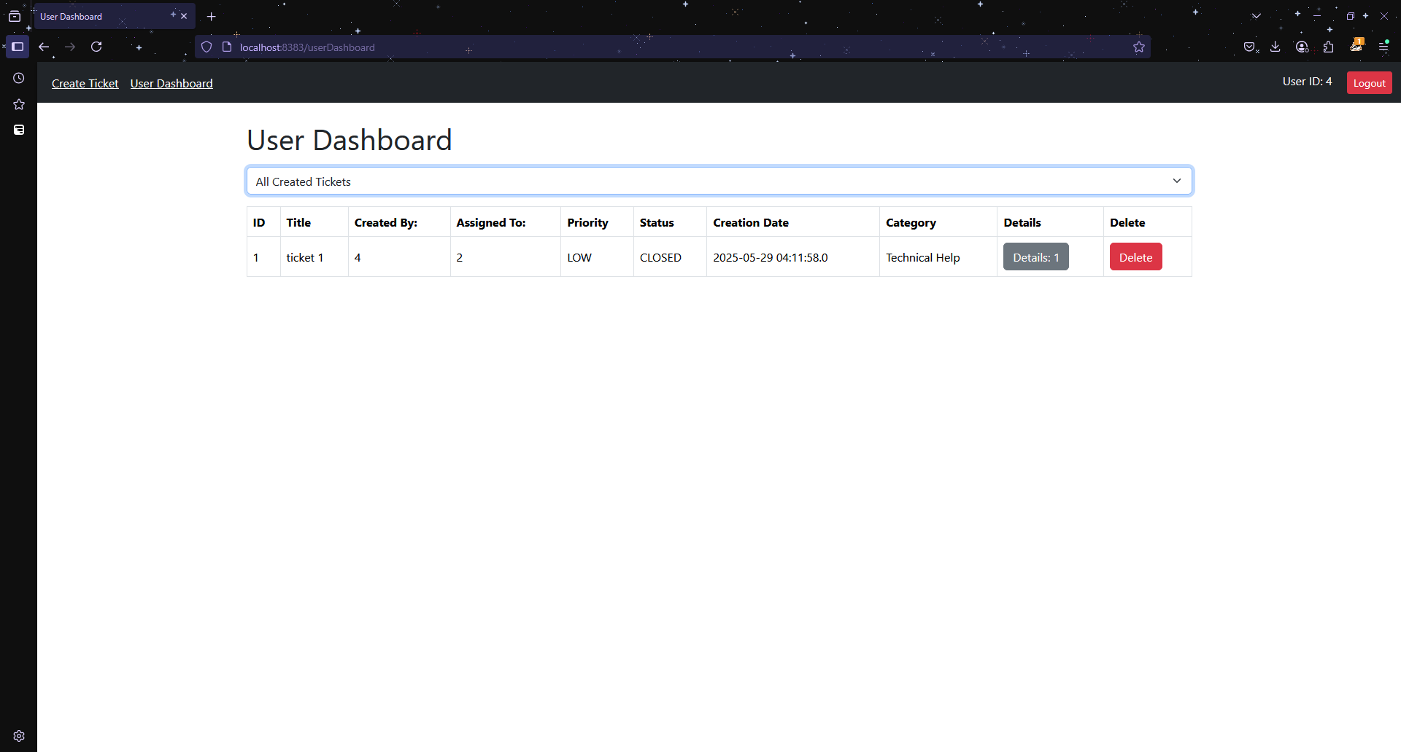
User Dashboard (closed/rejected tickets)

Slide 13
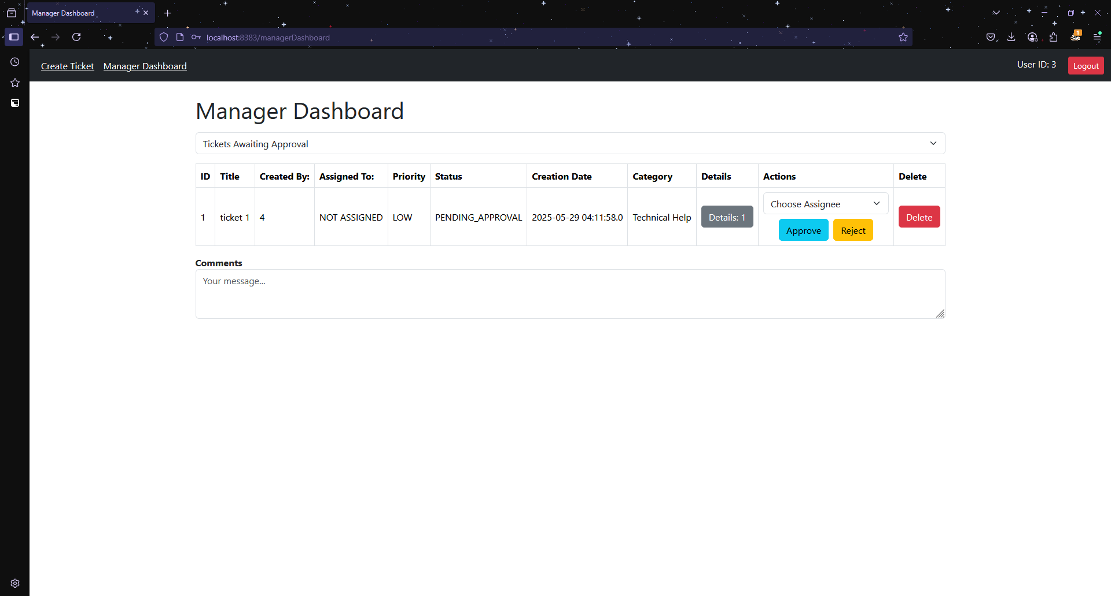
Manager Dashboard (pending tickets)

Slide 14
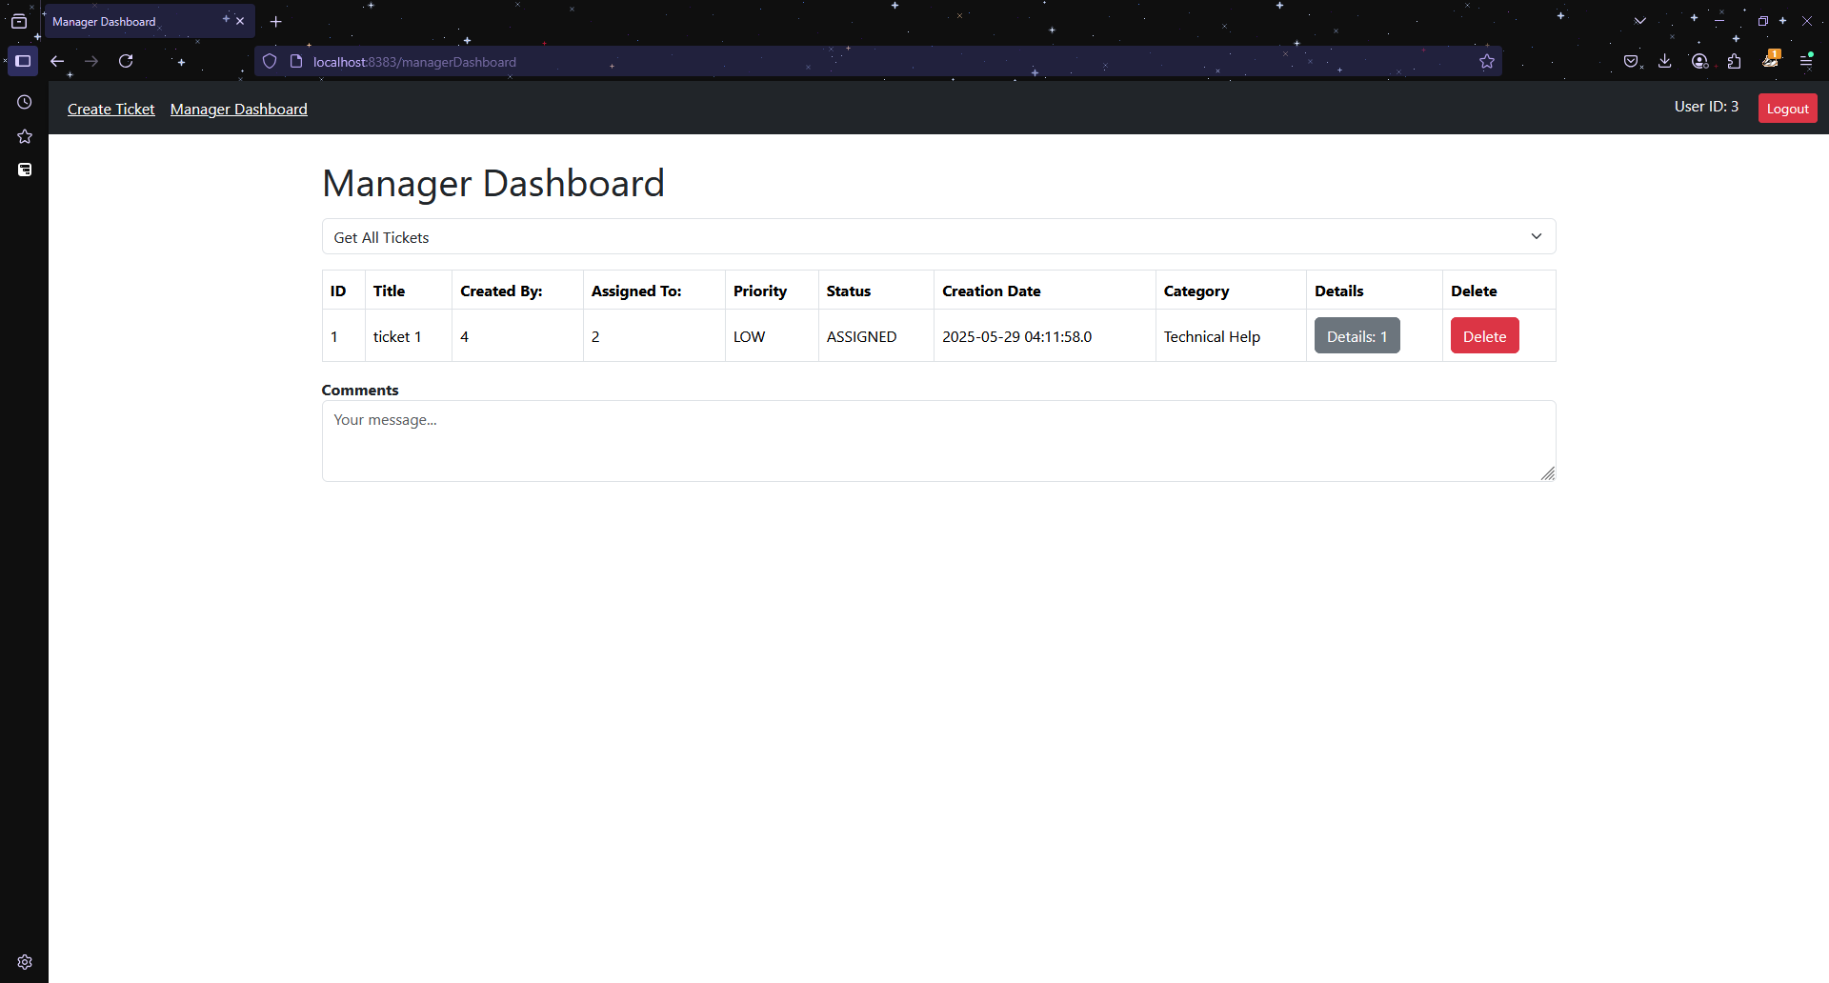
Manager Dashboard (all tickets)

Slide 15
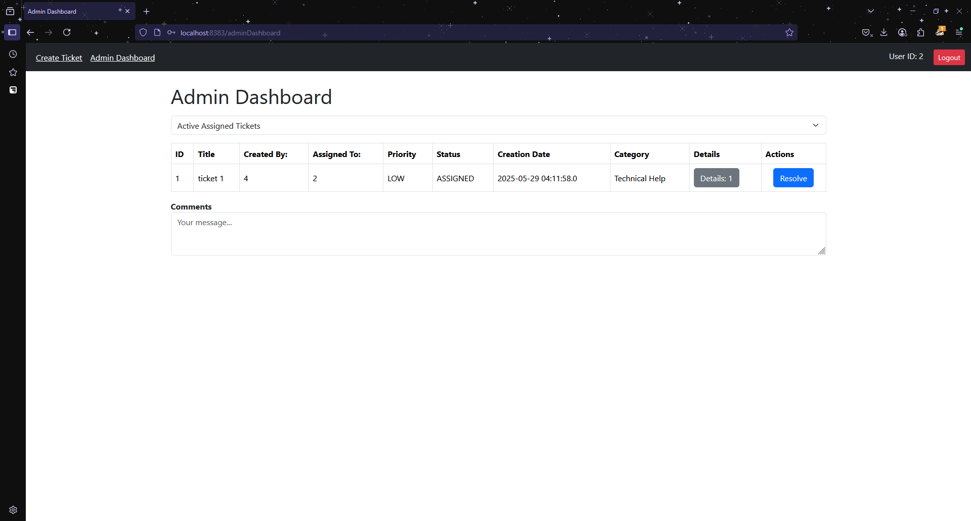
Admin Dashboard (assigned tickets)

Slide 16
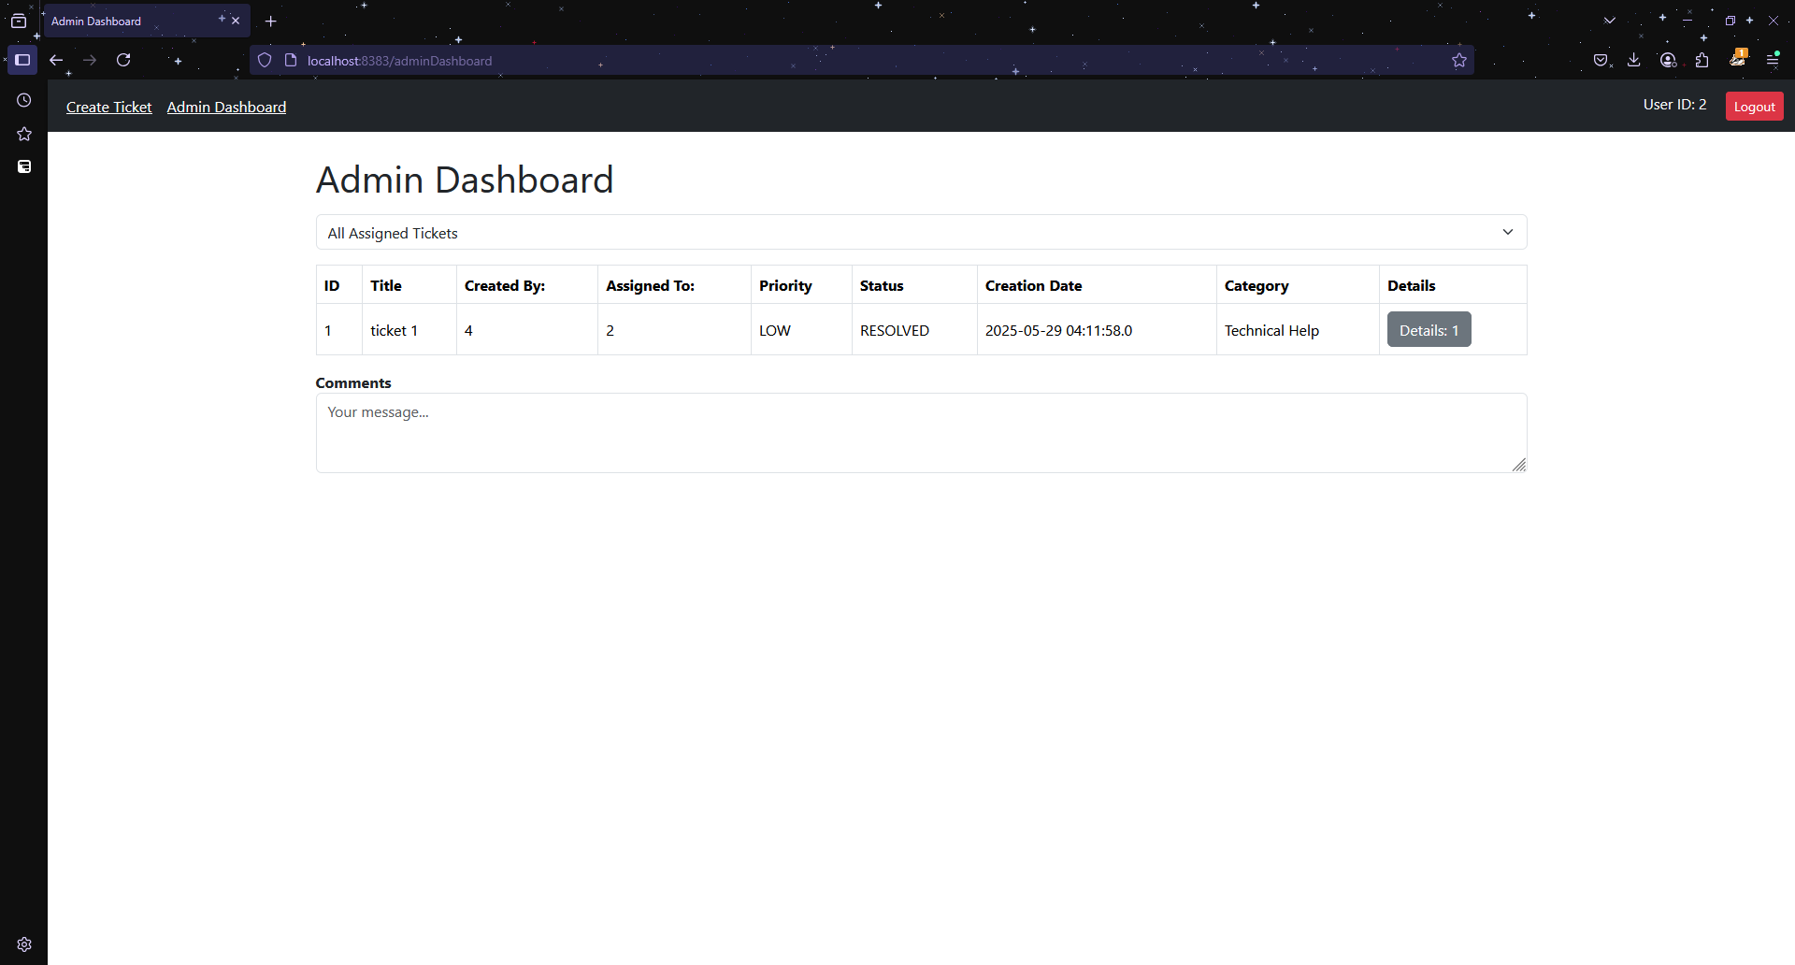
Admin Dashboard (all previously assigned tickets)

Slide 17
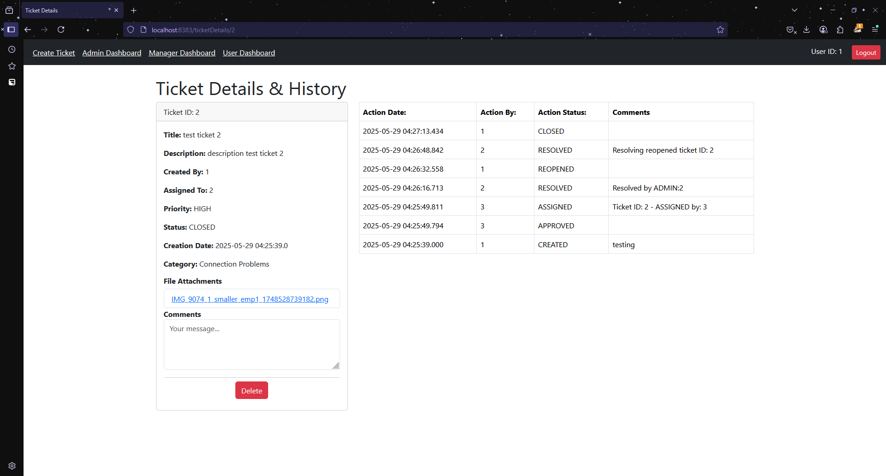
Ticket Details (User)

Slide 18
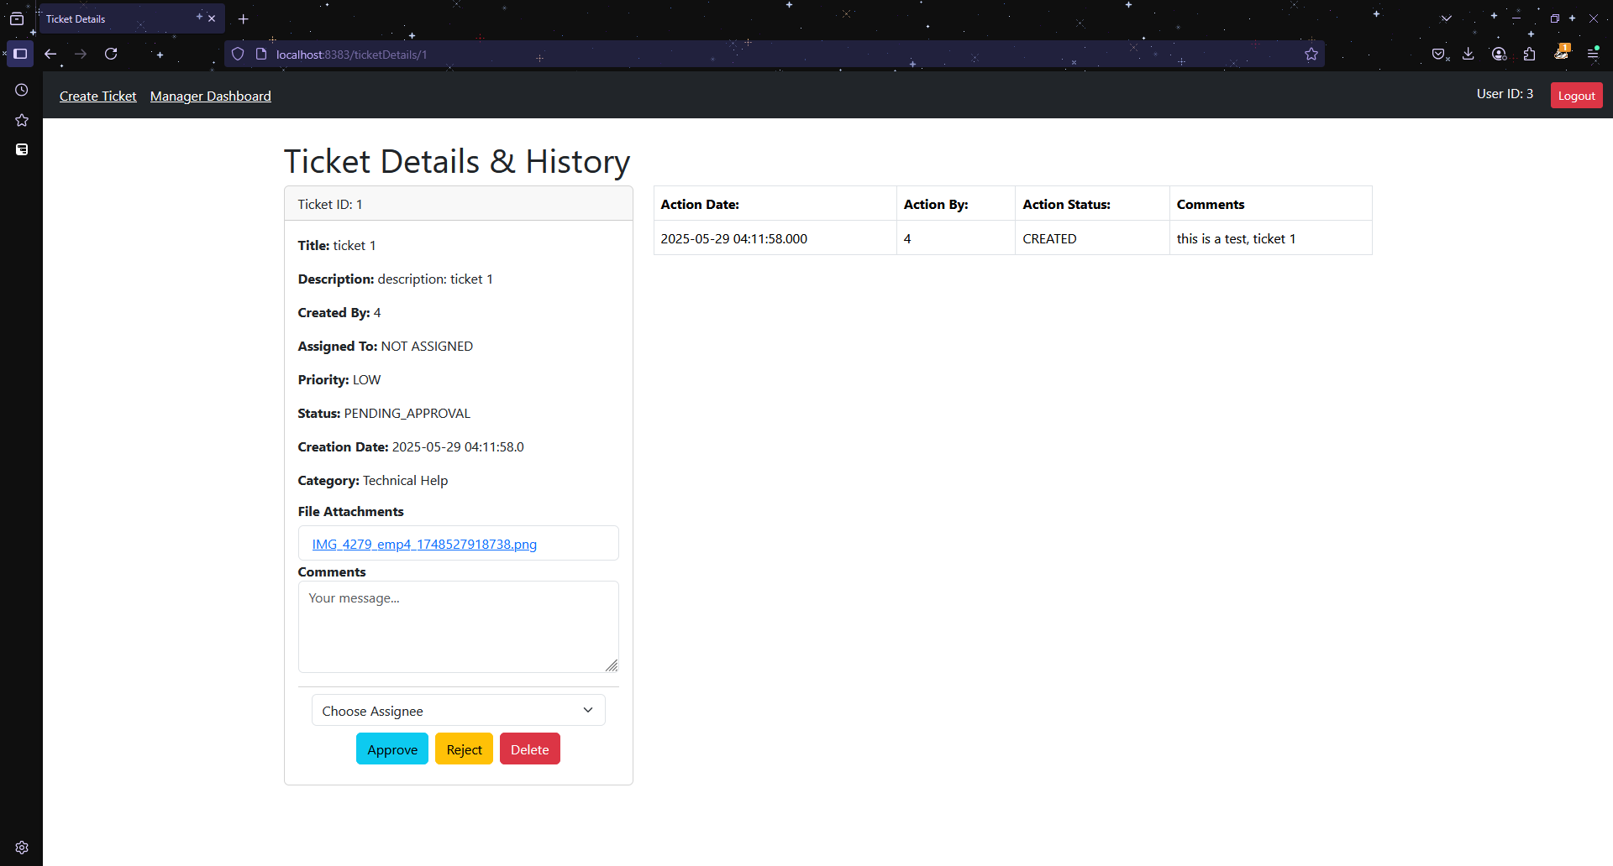
Ticket Details (Manager)

Slide 19
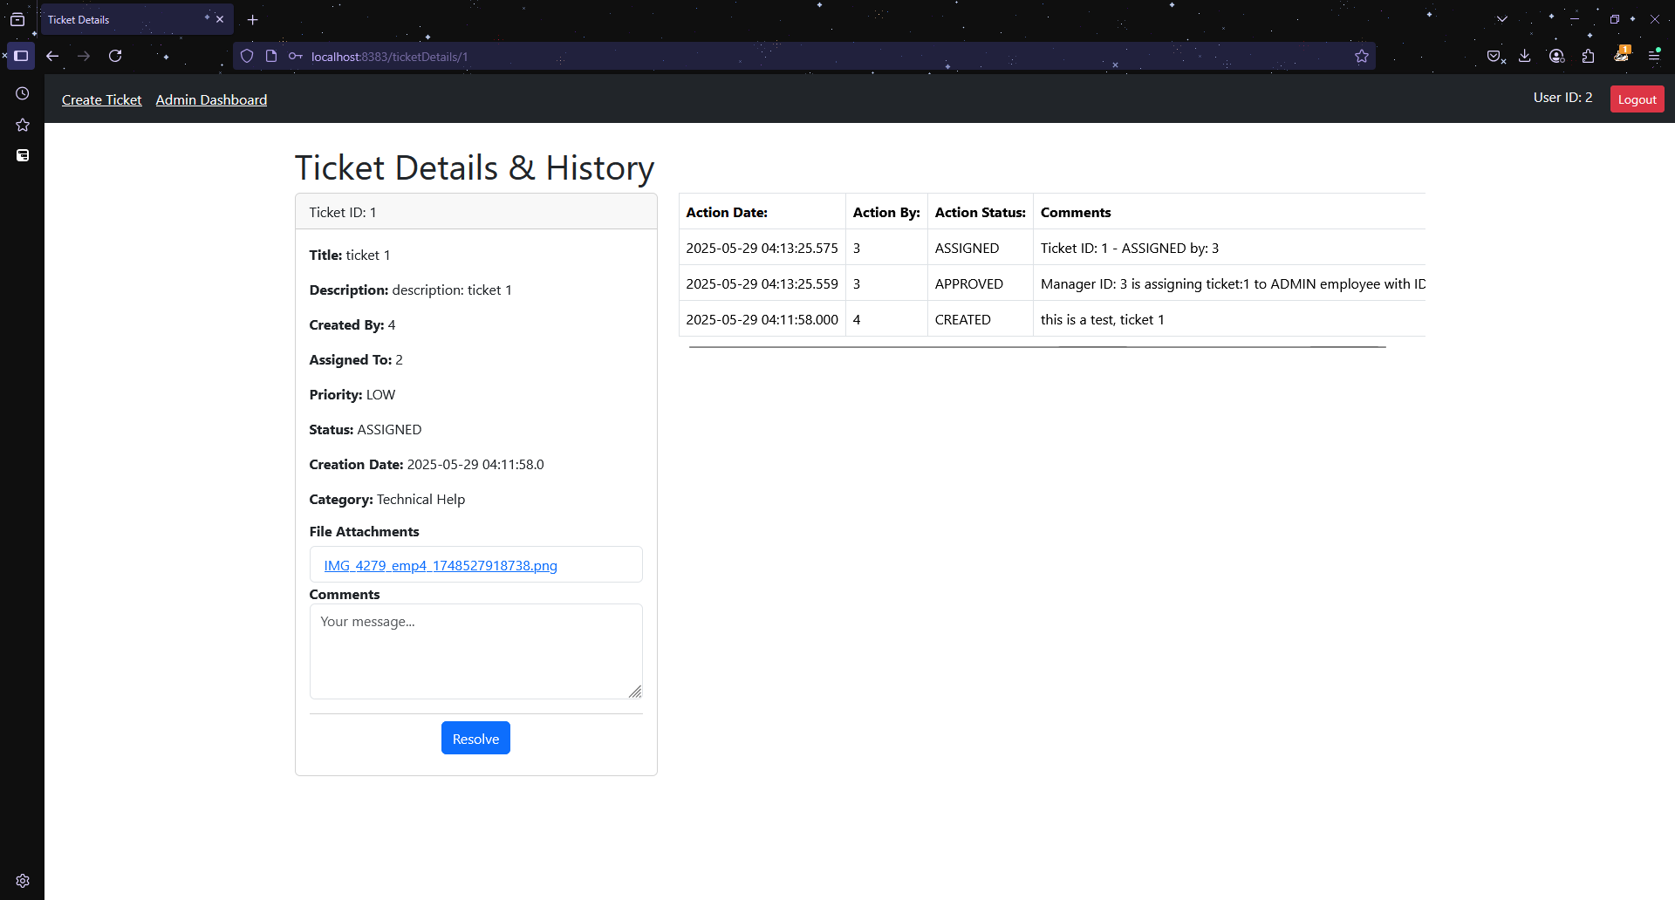
Ticket Details (Admin)

Slide 20
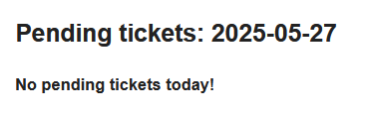
Email Notification - Manager (pending tickets)

Slide 21
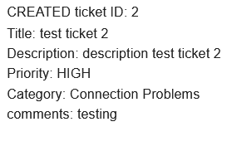
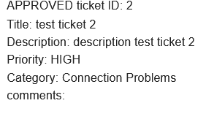
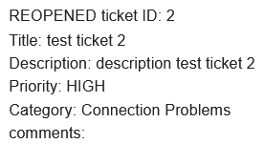
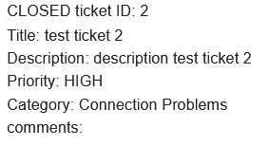
Email Notification - User (ticket updated)

Slide 22
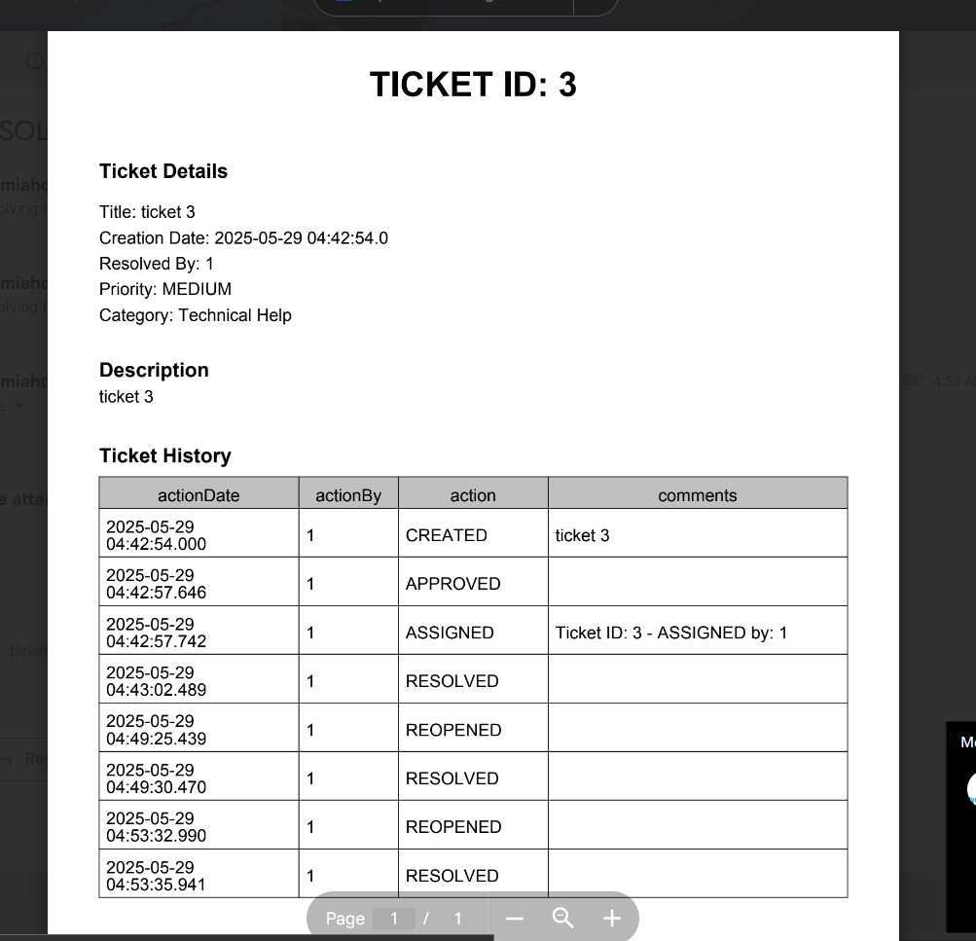
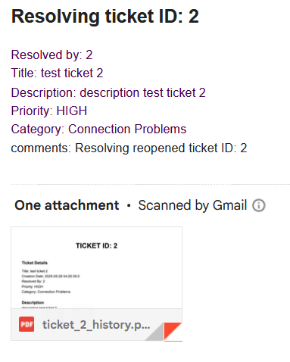
Email Notification - User (ticket resolved)

